Slide 1

CareerUp
A pathway to creativity in workplace

Slide 2
Problem
78% of employees who responded to a Harvard Business Review study said they work at organizations that lack diversity
Harvard Business Review

Slide 3
Introduction
Employee and Employer relations starts not from the day one of the job but right from the point of recruitment process.
CareerUp improves your organizations diversity by eliminating employer’s bias.
Provides confidence to job applicants by establishing a transparent process.

Slide 4
Solving the Problem
Masking out diversity parameters from recruiters' view.
Skillset driven analysis
Reduced processing time for applicants.
ML based profile generation and scoring.

Slide 5
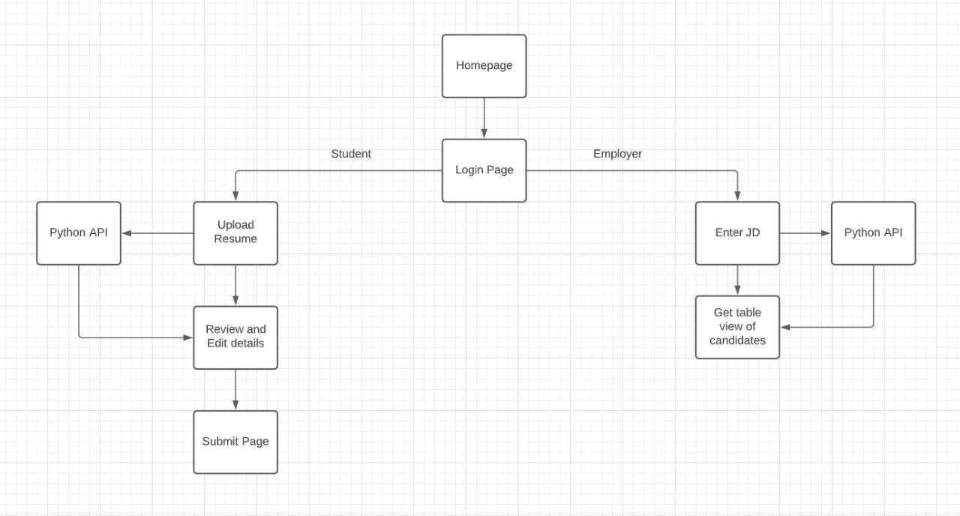
System Flow

Slide 6
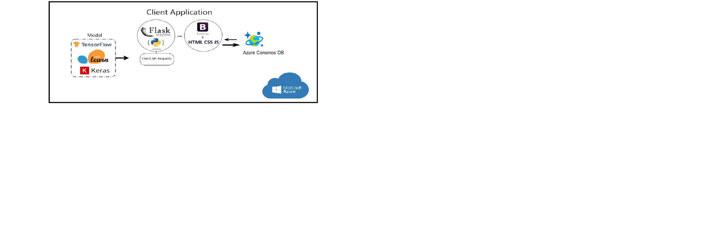
Technologies Used

Slide 7
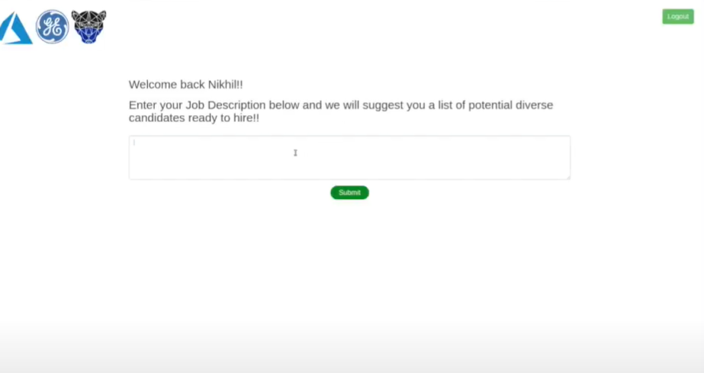
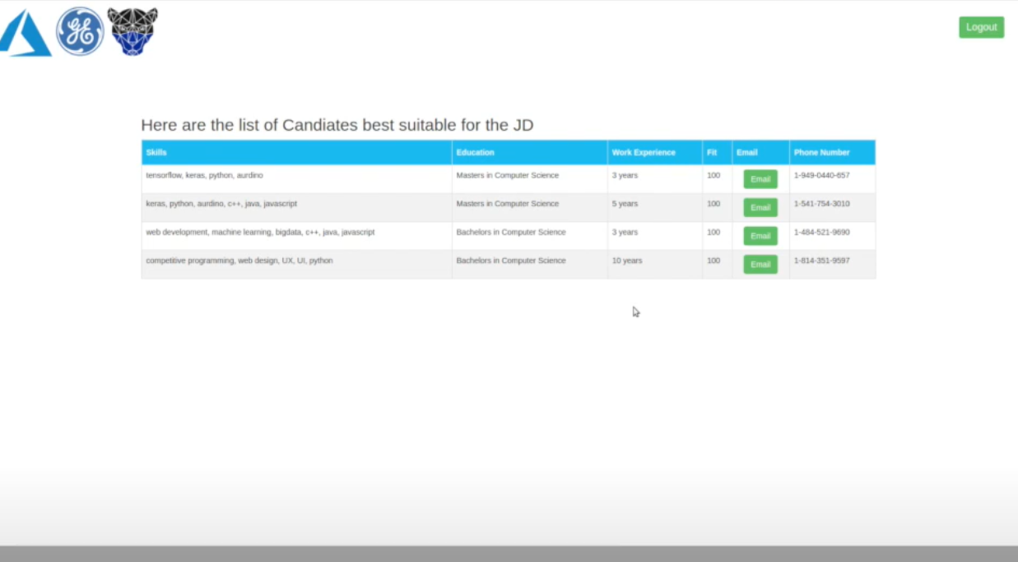
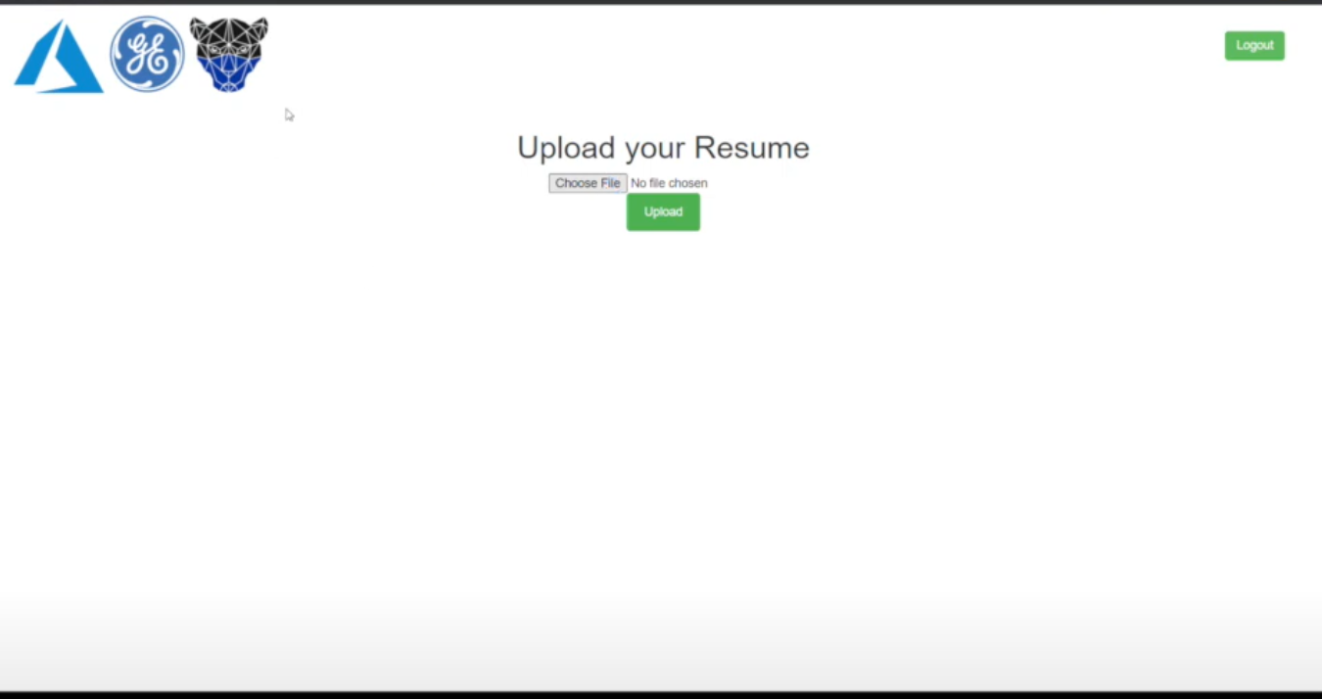
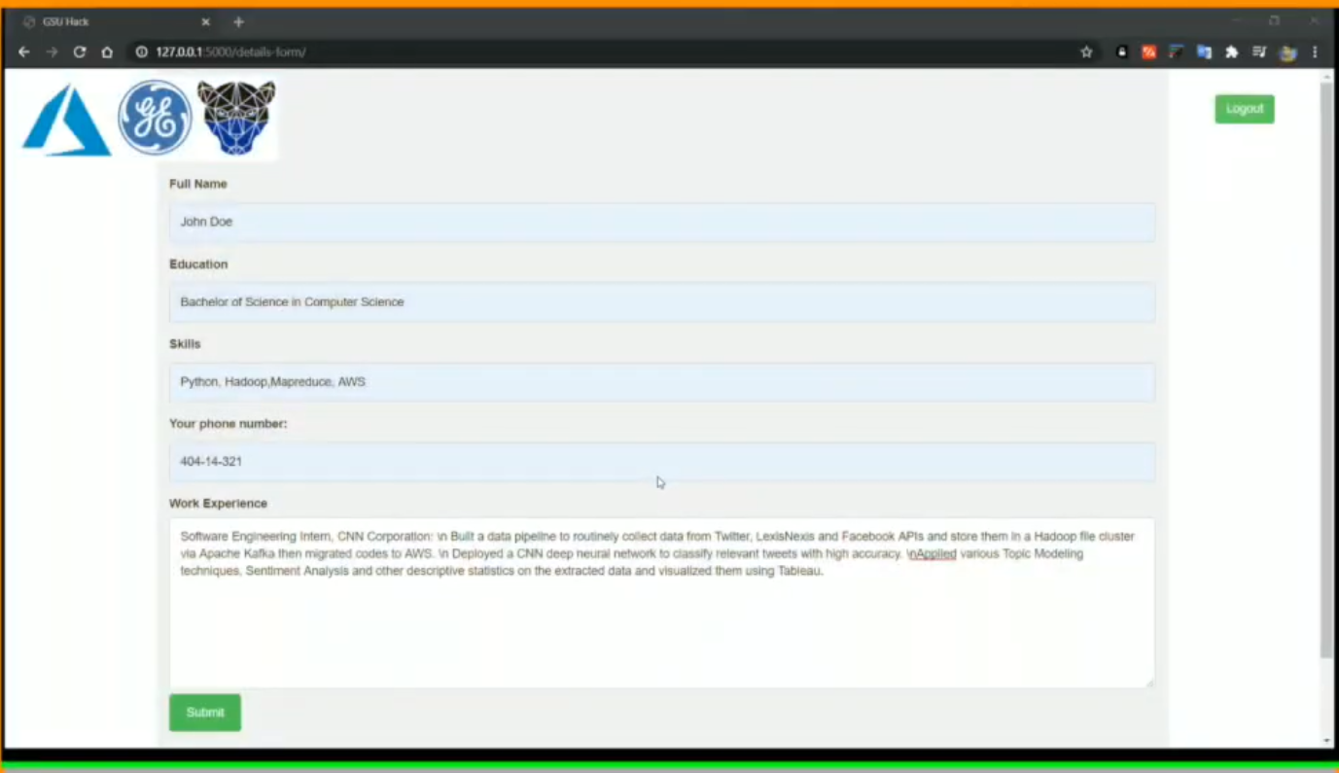

Career Dots

Slide 8
CareerUp Specialty?
State of the art NLP and Text Mining methods solving Recruiting and Job Seeking problem in a seamless and trust worth manner.
A unified job portal that functions two ways.

Slide 9

Thank You
Nikhil; Rohan; Rajath

